Slide 1
PREDICTING SONG POPULARITY
Designed by
Aishwarya Reddy Toom
Debomita Bhattacharjee
Devyani Singh
Nishant Anand
Pinkesh Nayak
Sasidhar Sirivella

Slide 2
BACKGROUND
Music is an integral part of our daily lives
50 Billion dollar industry
There are many stakeholders who would want to predict song popularity.
Examples:
• Venues
• Music distributors

Slide 3
Hypothesis and Desired Outcomes
Problem Statement: To identify the popularity of a given song
We chose this problem to understand the features that are important in predicting the popularity of a song
This can help an artist to understand if their song is going to be popular or not
• Using song features, build a model which can predict if a given song will be above or below the mean of song popularity scores of the data (0.487166)
• We chose 6 classification algorithms in order to compare the results and see which one gives us optimal results.

Slide 4
About Data
Million Song Dataset (MSD) is freely available collection of audio features and metadata for a million contemporary tracks
From The Echo Nest (now owned by Spotify)
Size of dataset - 300GB
One Million Songs
54 features and 1M records

Slide 5
Data Preprocessing
Downloaded the entire dataset on AWS EC2 node
Extracted all the metadata using Python and created a CSV summary file
Each song has 53 features such as Mode, Tempo, Duration, Title, End of Fade In etc.,
Traditional data cleansing
Removed records that are missing year or song popularity metric
Removed Variables with zero variance, zero cardinality and high cardinality
Removed columns which had more than 50% missing data
Removed columns which were not significant for our analysis

Slide 6
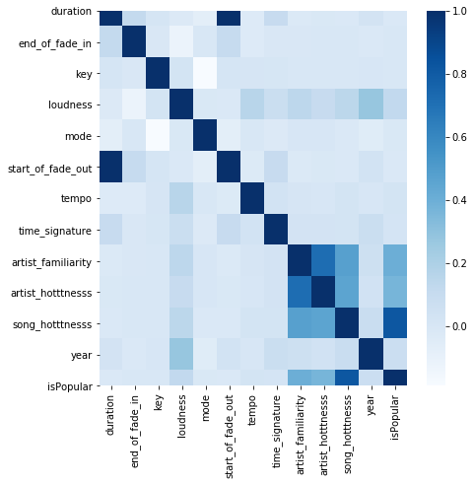
Data Exploration
After data cleansing, left with 306297 rows
Correlation matrix:
We can see a high correlation between
duration and start_of_fade_out
artist_familiarity and artist_hotness
song_hotness with artist_familiarity and artist_hotness

Slide 7
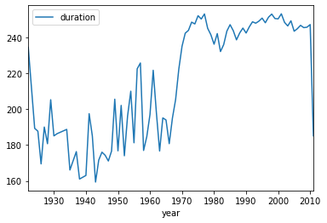
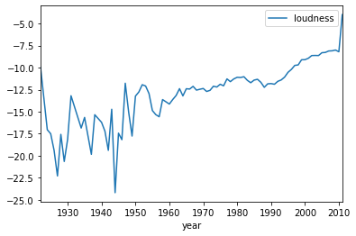
Data Exploration
• Data Trends over the years

Slide 8
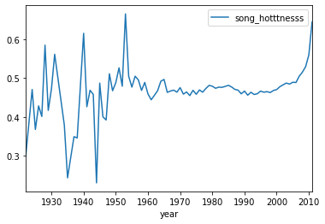
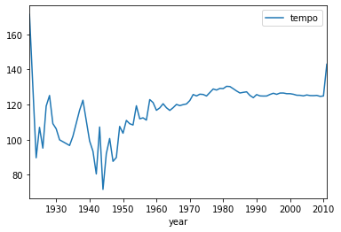
Data Exploration
• Data Trends over the years

Slide 9
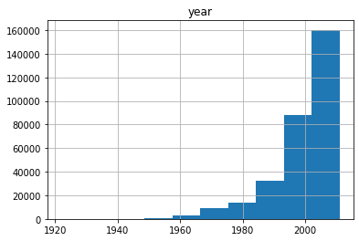
Data Exploration
• Number of Songs Over the years

Slide 10
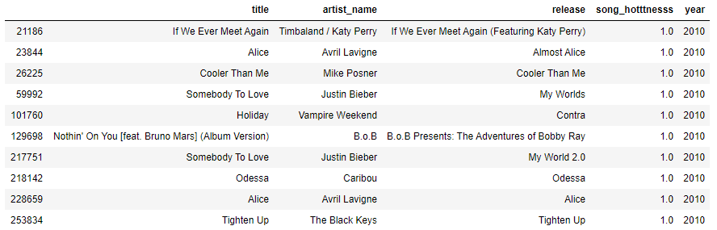
Data Exploration
Most Popular songs sorted by song popularity and year

Slide 11
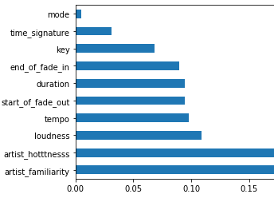
Feature Importance and Top Features
Extra Trees Classifier to determine feature importance score
We have removed variables which are not significant to our analysis :
Mode, time_signature, key
By removing these variables we were able to achieve high performance because their p-value is high and does not contribute significantly to our model
We have verified these features using RFE (Recursive Feature Elimination)

Slide 12
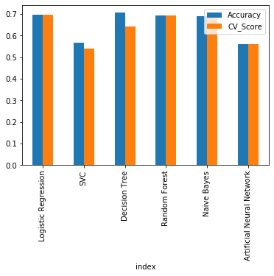
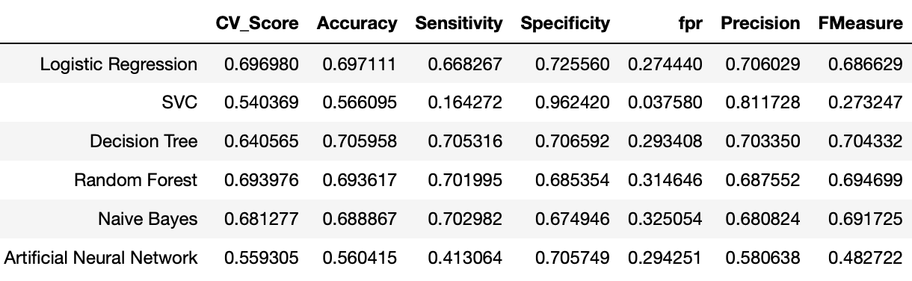
Model Selection

Slide 13
Model Evaluation
Logistic Regression gives the best accuracy of all the models tried
It also had the best Cross validation Score and Accuracy (0.69 and 0.69)
Parameters for model building
For Random forest: 100 decision trees
We tried altering the parameters like max_depth, n_estimators to maximize accuracy

Slide 14
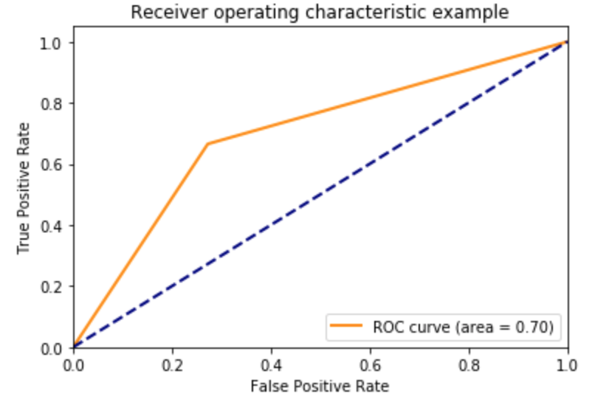
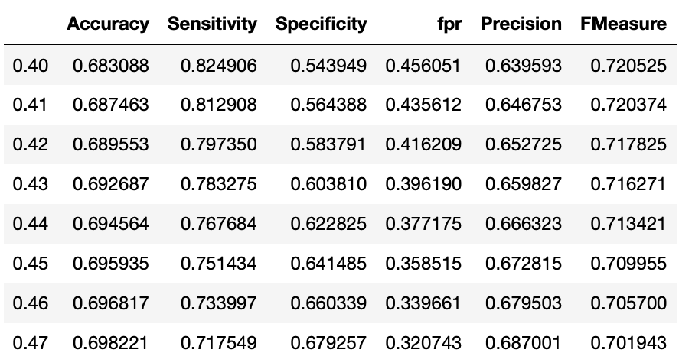
Model Evaluation
We have achieved an area under curve of 70%
We have also validated the model by checking the evaluation metrics for different thresholds

Slide 15
Conclusion, Future and Spin-offs
• Predicted song popularity based on song features
• Artist familiarity, Artist Hotness, Loudness, Tempo, End of Fade In are top five features
• Logistic Regression gave the best results
• Future
• Include song genres, most frequent words in lyrics as features
• Spin-off Projects
• Use similar tracks and similar artists information to create inter-relationship map for artists and songs

Slide 16


Thank You

